Slide 1





STOCK MARKET FORECAST
Team : AMRESH.T
Email : Amresh.thangavelu@gmail.com
Guide: (P.Raja, Master Trainer )
Disclaimer: The content is curated for educational purposes only.
Notes:
Slides: Prepare a short slide deck (10-12 slides) summarizing the project objectives, methodology, and key results.

Slide 2
OUTLINE
Abstract
Problem Statement
Proposed System/Solution
Algorithm & Deployment
GitHub Link
Project Demo(photos / videos)
Conclusion
Future Scope
References

Slide 3
Abstract
The stock market prediction is a complex task due to its volatile nature, with prices constantly shifting in response to various factors. Accurate predictions are critical for investors seeking to maximize returns, but the unpredictable influences make this a challenge. This paper explores recent advances in stock market prediction, focusing on Artificial Neural Networks (ANN), Neuro-Fuzzy Systems, Time Series Linear Models (TSLM), and Recurrent Neural Networks (RNN). Each technique’s strengths and limitations are examined, contributing to a framework for selecting suitable predictive methods.

Slide 4
Problem Statement
Discuss the inherent challenges of predicting stock prices due to economic, political, and psychological factors. Elaborate on the importance of accurate forecasting for various stakeholders, including individual investors, corporations, and governments.

Slide 5
Proposed Solution
To solve the problem of comparing stock prediction techniques, specifically Artificial Neural Networks (ANN) and Support Vector Machines (SVM), the solution involves creating predictive models using historical stock data. Each model should be trained with relevant parameters, followed by a performance comparison. Key components include data preprocessing, model training, testing, and analysis of predictive accuracy and reliability under varying conditions. The goal is to evaluate the strengths and limitations of each technique in predicting stock trends, focusing on factors like performance consistency, error rates, and sensitivity to data noise.

Slide 6
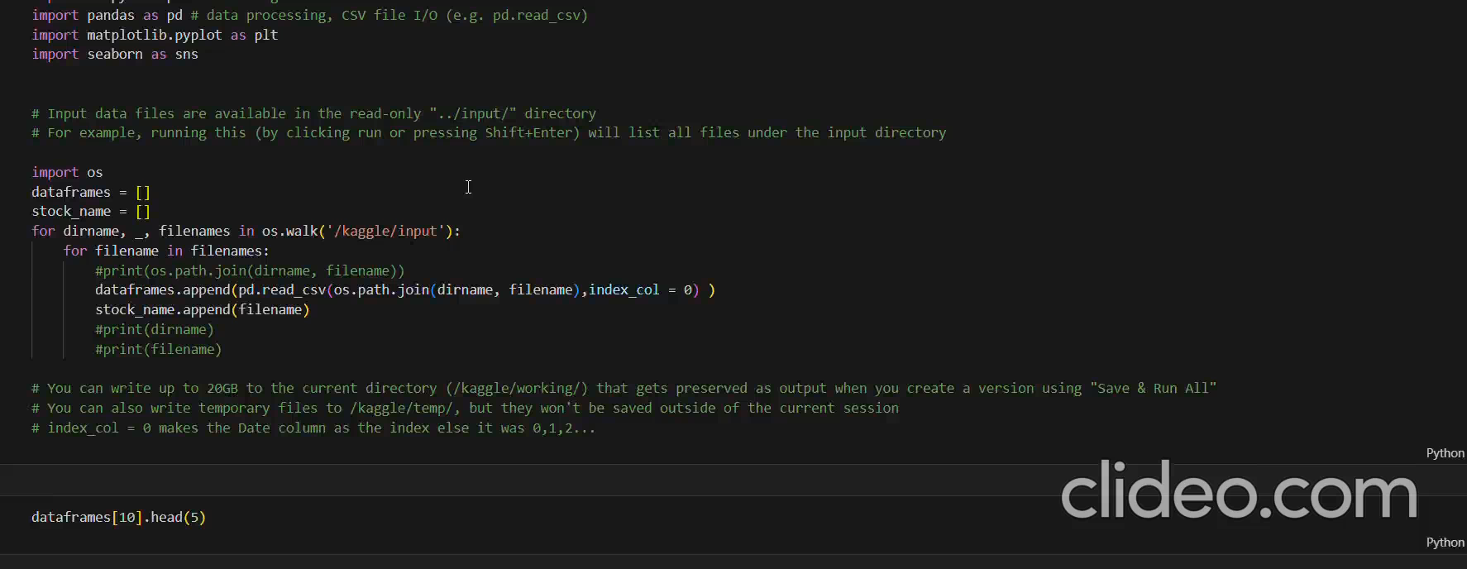
Video of Project Demo

Slide 7
Conclusion
This project highlights the effectiveness of predictive models like artificial neural networks (ANN) and support vector machines (SVM) in stock market forecasting. Each technique has unique strengths—ANN offers accuracy in predicting trends with low error rates, while SVM handles data variations well, enhancing model reliability. However, limitations such as noise sensitivity in ANN and potential overreactions in SVM emphasize the need for continual refinement. The project underscores the potential for integrating additional data sources and real-time analytics, paving the way for robust, accessible, and adaptable stock prediction tools.

Slide 8
Future Scope
User Interface and Accessibility
Global Market Expansion
Incorporating Sentiment Analysis
Real-time Data Processing
Enhanced Prediction Accuracy

Slide 9
Thank you!
Notes:
thank you very much for joining this PPT, keep learning.
9

